Slide 1
BIOMEDIN 215 Data Science in Medicine
Nigam Shah, MBBS, PhD
nigam@stanford.edu
Notes:
Intro
Continuation of last lecture
Feedback on what needs clarification

Slide 2
Recap: we want a model that is…
Fair: Promotes health equity and doesn’t exacerbate health disparities
Useful: Is useful for patients and for providers in guiding decision making
Reliable: Predicts outcomes well across subgroups, sites, and time.
Monetary value: Is cost-effective for the healthcare system to build (or buy) and use.

Slide 3
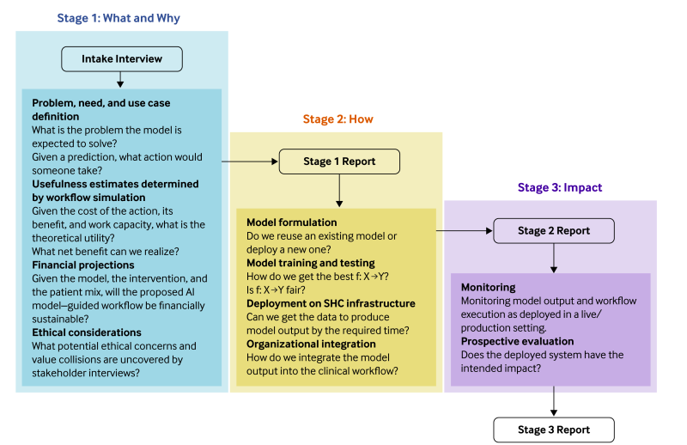
Recap FURM – http://furm.stanford.edu

Slide 4
Goals for today
We’ll discuss approaches and challenges in:
Assessing impact of modeling choices
Ensuring fairness
Usefulness under capacity constraints
Liability and regulation
Each section will include a summary of suggestions for you to keep in mind as you develop and deploy models yourselves!
Notes:
Note. Currently missing interpretability

Slide 5
Impact of modeling choices

Slide 6
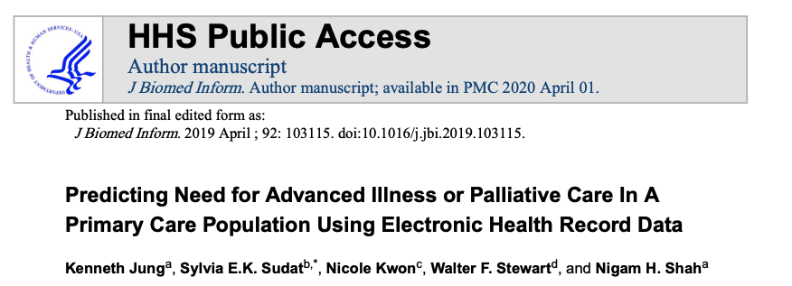
Some choices that can significantly impact your model
Data
Lead time for predictions
Outcome definition. i.e. label choice

Slide 7
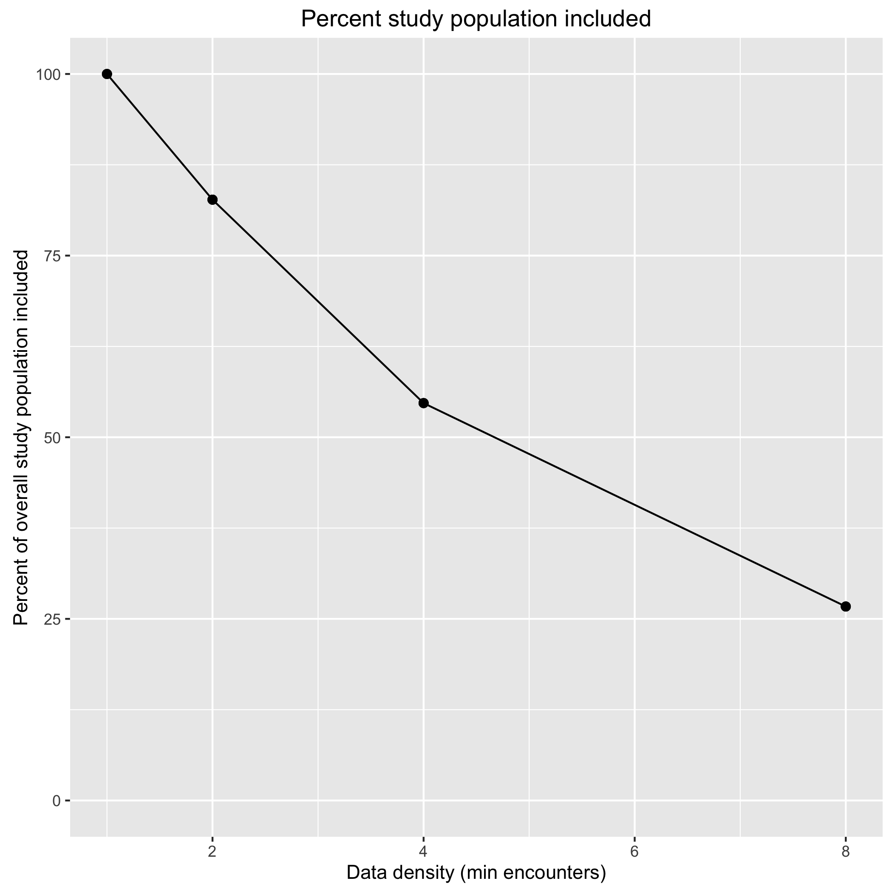
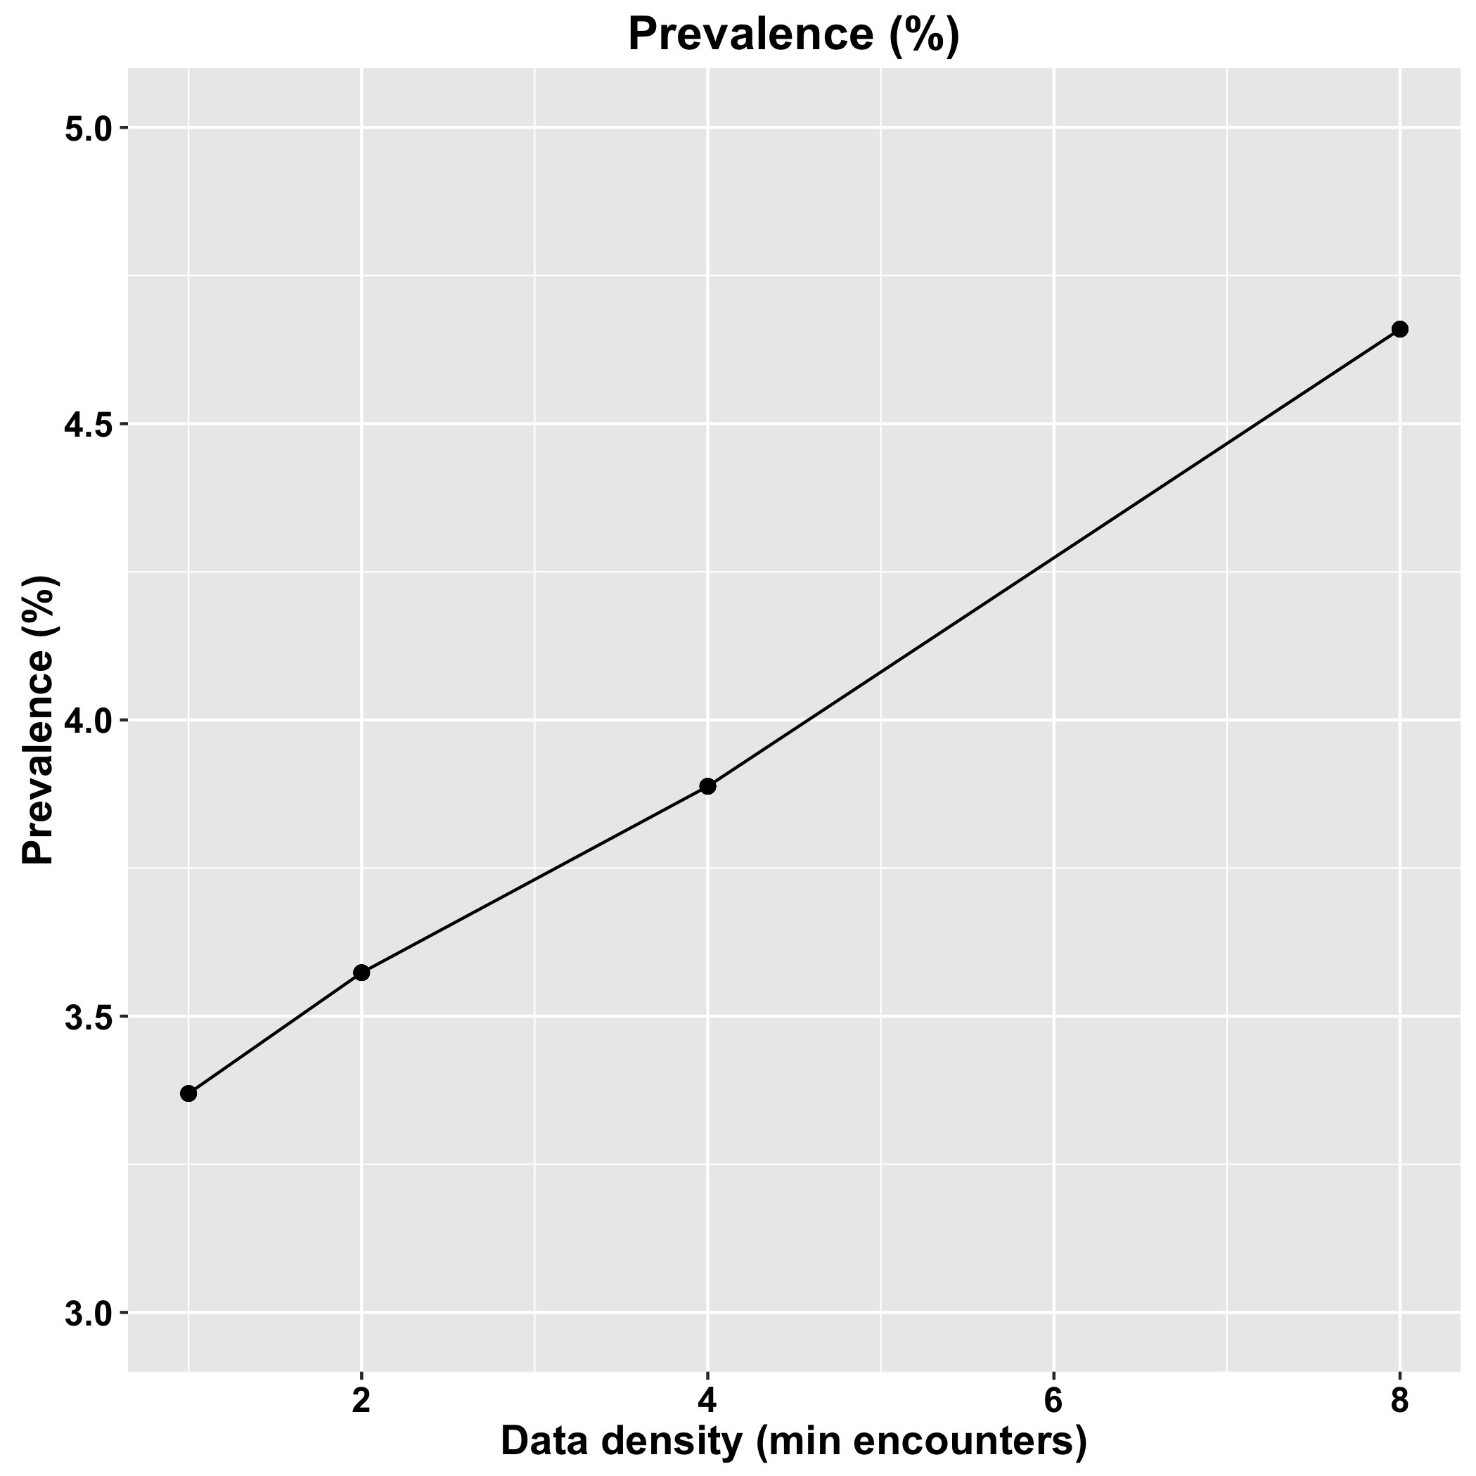
Ex. Impact of data density on eligible population and outcome prevalence
As data density requirements increase, the fraction of the population included (and for whom the model would be applicable later) falls
Because patients with higher data density tend to be sicker, as data density increases, the prevalence of the outcome (death) increases
Jung et al. “Predicting Need for Advanced Illness or Palliative Care In a Primary Care Population Using Electronic Health Record Data ”.
https://doi.org/10.1016/j.jbi.2019.103115.
Notes:
Also important to think carefully about what data you want to include, and who such data does and doesn’t represent

Slide 8
Lead time impacts the actions we can take in response to predictions
Action | Public Heath | COVID19 cases next week | Next year’s flu season
Action | Operational | Long length of stay Discharge in next 24h | Late wound healing Undiagnosed FH
 | Medical | Having Sepsis Acute Kidney Injury Cardiac arrest | 3–12-month mortality Cost-Bloom in one year
 |  | Near term | Long term
 |  | Lead time

Slide 9
Ex. Impact of index and outcome time choices on model performance
July 1
2011
July 1
2012
July 1
2013
July 1
2014
-
+
-
+
…
Labels for training
Model performance by lead time:
87.9% for patients who died within 0 to 3 months
83.6% for patients who died within 9 to 12 months.
Jung et al. “Predicting Need for Advanced Illness or Palliative Care In a Primary Care Population Using Electronic Health Record Data ”.
https://doi.org/10.1016/j.jbi.2019.103115.
Notes:
We construct a supervised learning problem for the task of predicting all causes mortality within a year. The dataset comprises patient level EHR data from July 1, 2011 through July 1, 2014.
We represent each patient’s timeline as a horizontal line, with events shown as blue dots (for clinical encounters) or vertical red bars (for mortality).
We construct a supervised learning problem as follows.
For each patient we pick a random time in the second year of the study period.
We then use the data from the year prior to these times (green segments) to predict the probability of mortality in the follow-up period (red segments).
Positive cases are patients whose timelines end during their follow-up period (2nd and 4th rows).
Lead time offered is a metric we examine

Slide 10
Ex. Impact of outcome definition
Mortality predictions assume that the “usual care” continues to happen.
Survival predictions are inherently causal, because we want to know what will happen under treatment A, vs. treatment B.
Mortality predictions can not be interpreted as survival predictions.
Notes:
-Mortality prediction identifies a problem (whether someone will die), but they don’t tell you what the best decision is in that scenario
A causal analysis (exploring whether treatment A vs. B is better) can help with decision-making, but it’s also an entirely different problem

Slide 11
Remember
Define a label so that a prediction offers you lead time to take some action
01
Make sure your test set is from a future time (and not a patient level split!)
02
Use domain knowledge to manufacture features
03
Connect with the wound healing lecture video
Notes:
Find a condition with a low prevalence (e.g. 1-3:100), where the pre-test probability is too low to offer an intervention to everyone.

Slide 12
Ensuring Fairness

Slide 13
Ex. Obermeyer et al, 2019
Health care costs and health needs are highly correlated, as sicker patients need and receive more care, on average.
Realized costs versus predicted risk.
algorithm-predicted risk vs. illness burden
Ziad Obermeyer et al. Science 2019;366:447-453
Notes:
The basic premise of this paper was to examine an algorithm used by US hospitals to to allocate really sick patients to high risk care management programs; since these are very resource-intensive and expensive, the idea was that the model could help identify which patients would get the most benefit from such a program.
These results suggest that the driving force behind the bias we detect is that Black patients generate lesser medical expenses, conditional on health, even when we account for specific comorbidities. As a result, accurate prediction of costs necessarily means being racially biased on health.
How might these disparities in cost arise?
Poor patients face substantial barriers to accessing health care, even when enrolled in insurance plans. Although the population we study is entirely insured, there are many other mechanisms by which poverty can lead to disparities in use of health care: geography and differential access to transportation, competing demands from jobs or childcare, or knowledge of reasons to seek care.
Race could affect costs directly via several channels: direct (“taste-based”) discrimination, changes to the doctor–patient relationship, or others.

Slide 14
What do you think went wrong here?

Slide 15
My take on the media ruckus
If the data are always a certain way, the model learns that (that is what machine learning does).
If you train a model to do "task A" and it fails at "task B”, that is bias arising from label choice (the author of the study says that).
The data, the label choice, and the algorithm.
mathematical gimmickry can not fix the data.
hiding the label bias by misguided math is even worse.
saying that the algorithm is evil is silly.
I argue that it is *good* that the algorithm is learning the bias in the data, so we can do something about it.
e.g. the ASCVD equation is racially biased. I know it and so does my doctor, so we compensate for it.
Notes:
“The algorithm is not racially biased,” a company spokesman, Tyler Mason, wrote in a statement emailed to STAT in July. “The study in question mischaracterized a cost prediction algorithm used in a clinical analytics tool based on one health system’s incorrect use of it, which was inconsistent with any recommended use of the tool.”
https://www.statnews.com/2020/10/13/how-software-infuses-racism-into-us-health-care/
Media often complains about "biased algorithms", when in truth it is the data they learned from which are biased, and the humans who used them who made the sloppy causal assumption.
Using data with institutionalized bias.
If a certain population always got less care, the machine will learn that they get less care — it is the human's fallacy to infer that they need less care.
Bias due to label choice.
Predicting a surrogate and then finding bias for the primary outcome
Unequal allocation of an intervention given equal need.
Unequal efficacy of the intervention, and a difference in accrued benefit.

Slide 16
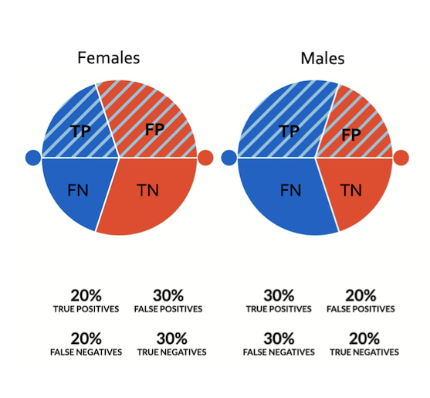
A simple example of a fairness metric
Group fairness: The chance of a positive prediction (TP+FP) should be be equal for each protected attribute
Female: 20% + 30% = 50%
Male: 30% + 20% = 50%
Notes:
Representative harm occurs when systems reinforce the subordination of certain groups along the lines of identity

Slide 17
Fairness methods aim to:
BUT: Current technical approaches to fairness can only address these two!
Identify & Mitigate systematic differences in model output in populations of interest
Predict outcomes equally well in populations of interest
Identify and mitigate upstream biases in data collection, problem formulation, and measurement
Ensure that model-guided interventions prevent the exacerbation of existing disparities and promote health equity
A
B
C
D

Slide 18
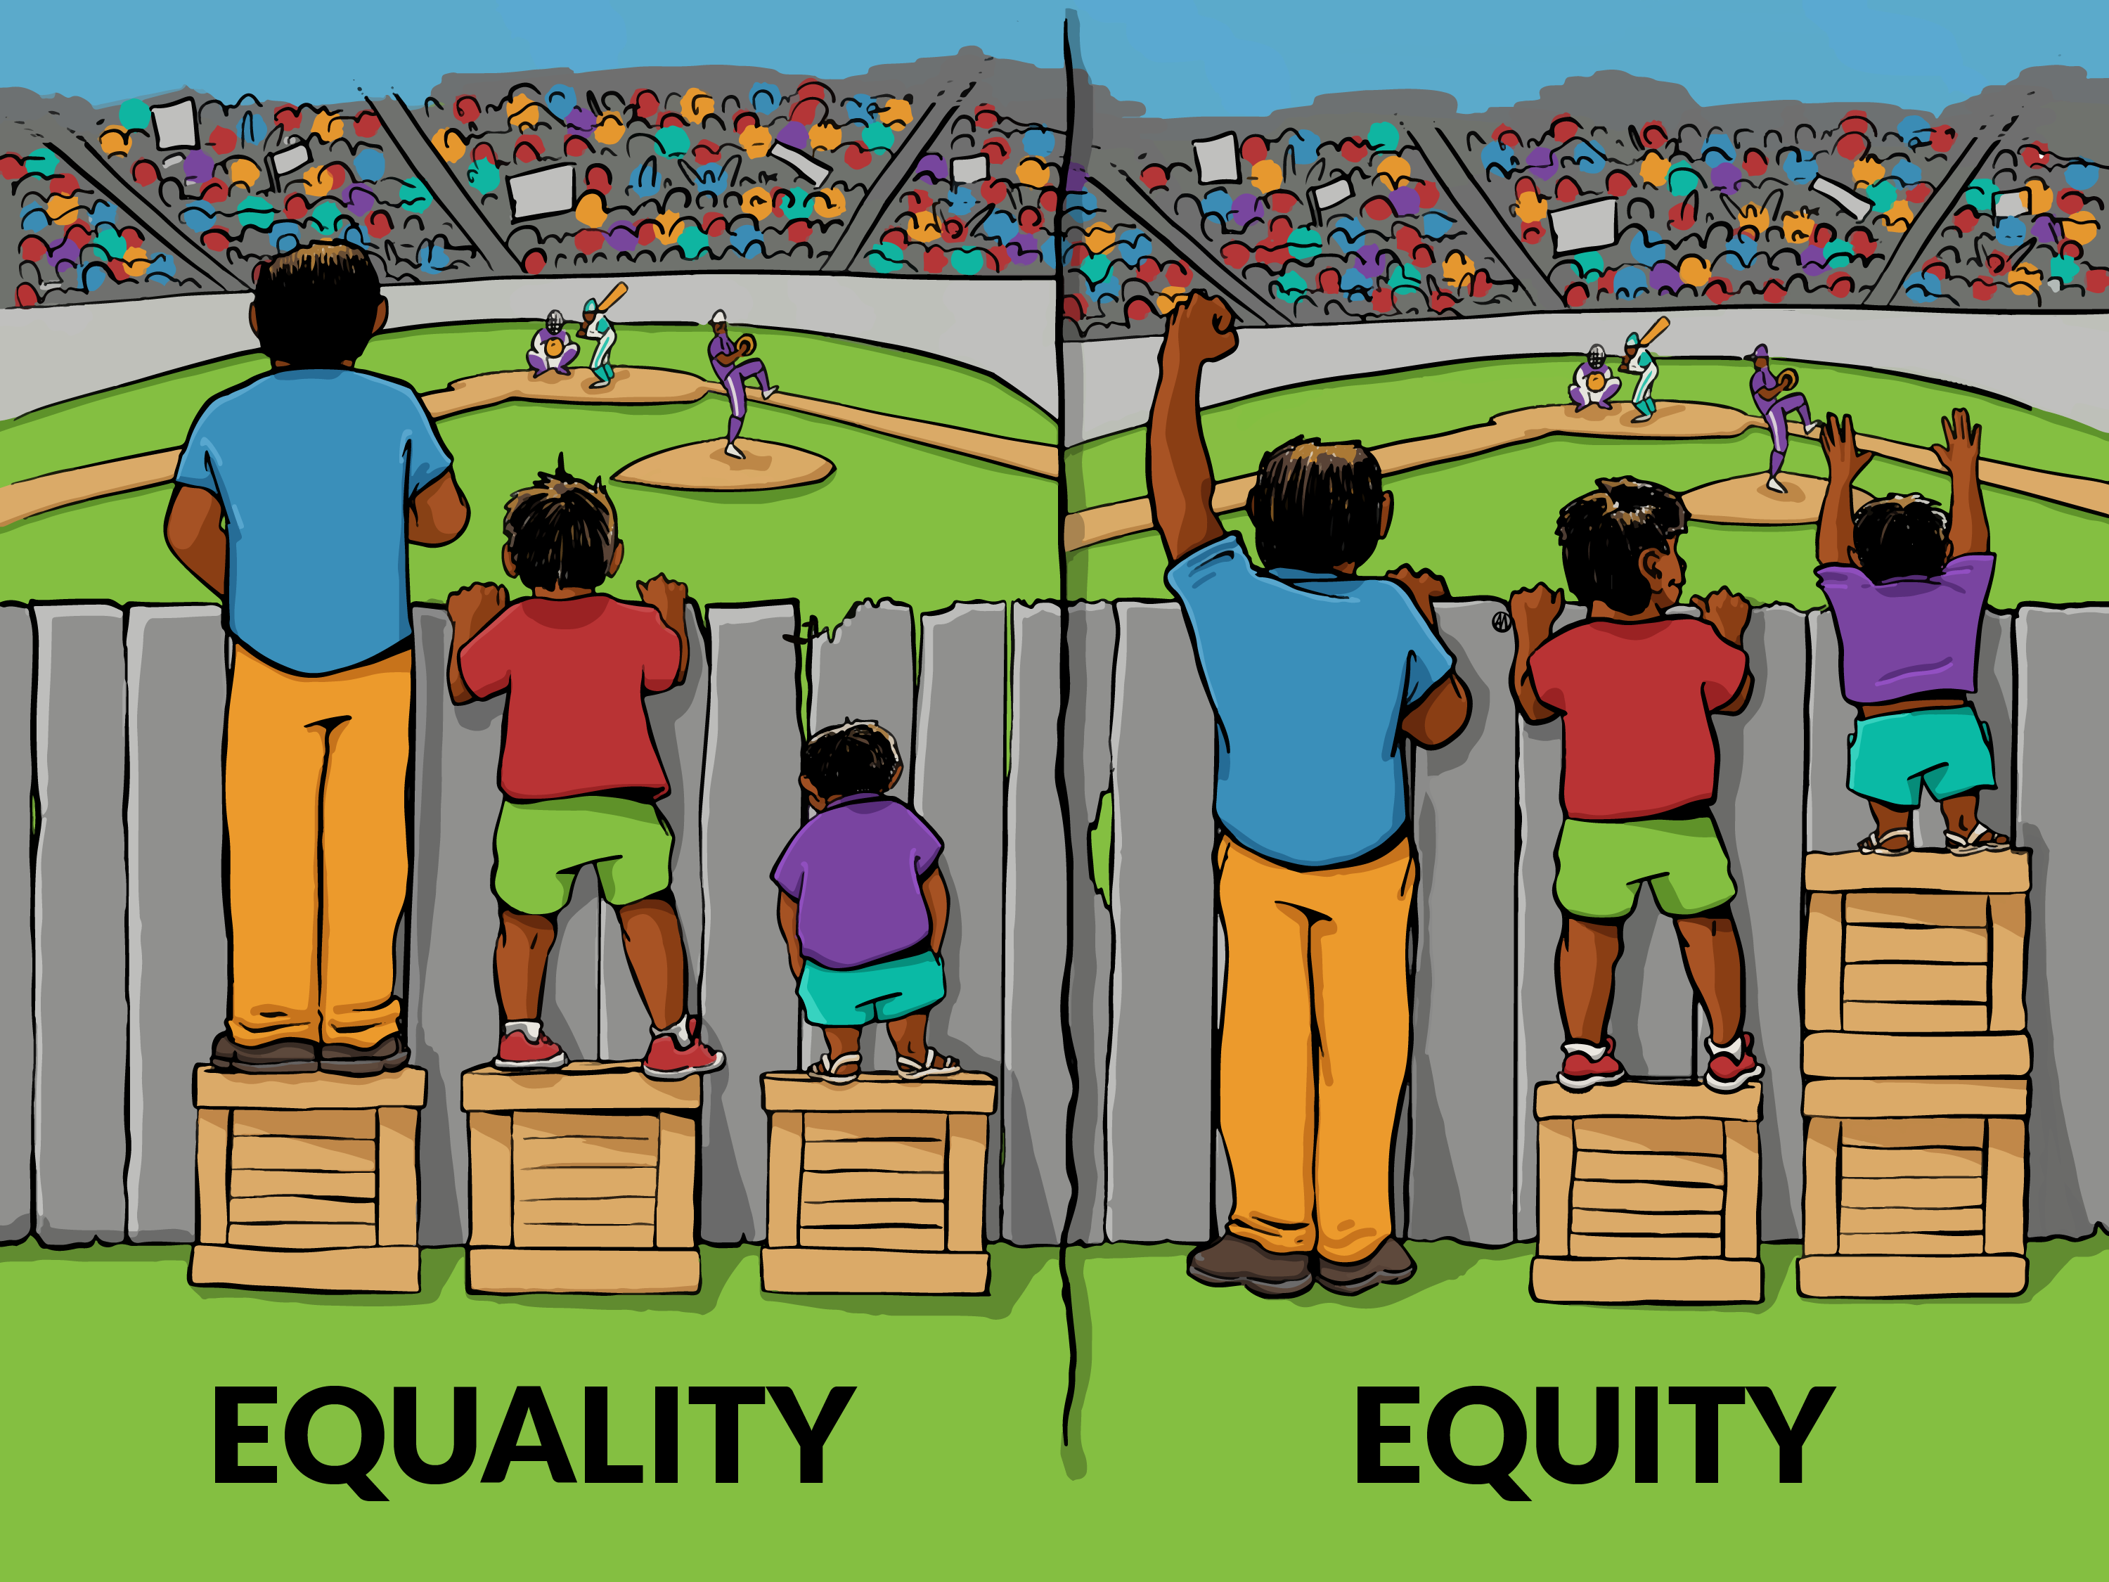
Fixing systematic differences in algorithm output is not enough to ensure equal accrual of benefit
Notes:
Fixing systematic different in the algorithm output is not enough to ensure equal accrual of benefit

Slide 19
Remember
Incorporate perspectives from diverse stakeholders in problem formulation and in metric design
04
Use fairness metrics for auditing, rather than as optimization criteria
05
Worry about the effect of policies and interventions on humans, not model performance per se
06
Connect with step 5 in FURM assessment
Evaluating fairness in the presence of clinical guidelines
http://dx.doi.org/10.1136/bmjhci-2021-100460

Slide 20
Usefulness under capacity constraints

Slide 21
What is utility?
The utility for an outcome quantifies the benefit associated with that outcome, in whatever units are most convenient or meaningful
This could be:
Total healthcare estimates in the 6 months following discharge
Amount of unwanted care avoided
Increase in patient comfort
Something else

Slide 22
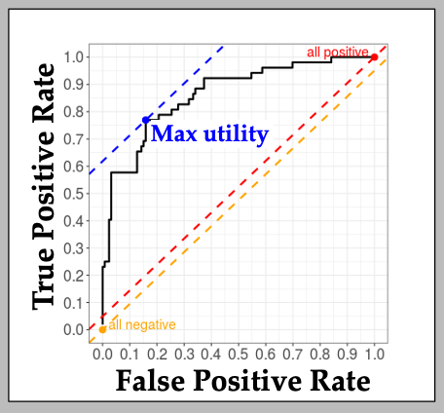
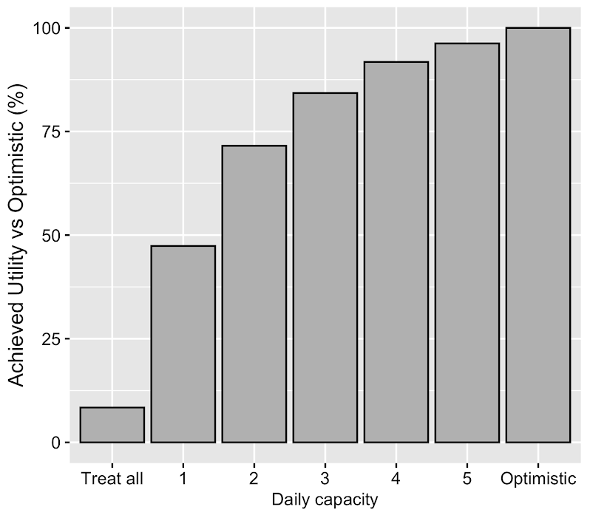
Steps 8-9: Achievable benefit
Is there utility, given cost and benefit of actions?
What is the achievable utility, given work capacity?
What is the effect of constraints on different parts of the workflow?
Notes:
https://analytics-dashboard.shinyapps.io/dashboard/
FN = 37,085 = Gade et al. original value of 21252 * inflation multiplier of 1.745
TP = 28,613 = Gade et al. Net savings of 4855 * inflation multiplier, subtracted from 37,085
FP = 14,970 = 11,646 + inflation adjusted cost of intervention (3,324)
TN = 11,646 = Per capita spend in US, 2018, Peterson-Kaiser
U (TP – FN) = 28,613 – 37,085 = -8,472
Spending $3,324 to save $8,472

Slide 23
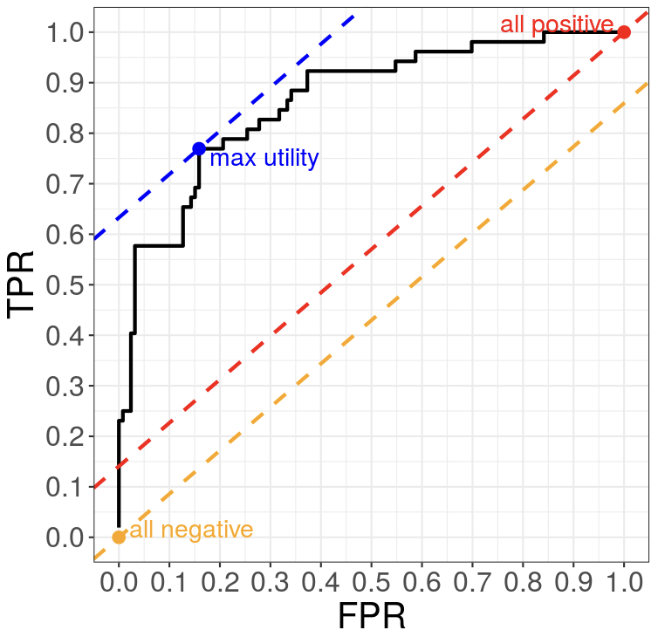
Is there utility, given cost and benefit of actions?
True positive rate
 | Positive (r_{p}=?%) | Negative (r_{n}=?%)
Positive | $28,613 * r_{p}*TPR | $14,970 * r_{n}*FPR
Negative | $37,085 * r_{p}*(1-TPR) | $11,646* r_{n}*(1-FPR)
Spending $3,324 to save $8,472
False positive rate
A framework for making predictive models useful in practice Kenneth Jung et al. https://doi.org/10.1093/jamia/ocaa318
Notes:
FN = 37,085 = Gade et al. original value of 21252 * inflation multiplier of 1.745
TP = 28,613 = Gade et al. Net savings of 4855 * inflation multiplier, subtracted from 37,085
FP = 14,970 = 11,646 + inflation adjusted cost of intervention (3,324)
TN = 11,646 = Per capita spend in US, 2018, Peterson-Kaiser
U (TP – FN) = 28,613 – 37,085 = -8,472
Spending $3,324 to save $8,472

Slide 24
History: ROC, Utility, and indifference lines
 | Positive (r_{p}=5%) | Negative (r_{n}=95%)
Positive | u_{tp}* r_{p}*TPR | u_{fp}* r_{n}*FPR
Negative | u_{fn}* r_{p}*(1-TPR) | u_{tn}* r_{n}*(1-FPR)
E(u) = u_{tp}* r_{p}*TPR + u_{fn}* r_{p}*(1-TPR) + u_{fp}* r_{n}*FPR + u_{tn}* r_{n}*(1-FPR)
E(u) = u_{tp}* r_{p}*1 + u_{fn}* r_{p}*(1-1) + u_{fp}* r_{n}*1 + u_{tn}* r_{n}*(1-1)
True positive rate
E(u) = u_{tp}* r_{p} + u_{fp}* r_{n}
E(u) = 100*5 + 2*95
E(u) = 690
690 = 100*5*TPR + 200* 5*(1-TPR) + 2* 95*FPR + 1*95*(1-FPR)
False positive rate
Red line: act on every case.
Yellow line: ignore every case.
Green line: current rule
Blue line: rule from a threshold on the model’s output
Notes:
Red line is for d=1, which means act on every case.
Yellow line is for d=0, which means ignore every case.

Slide 25
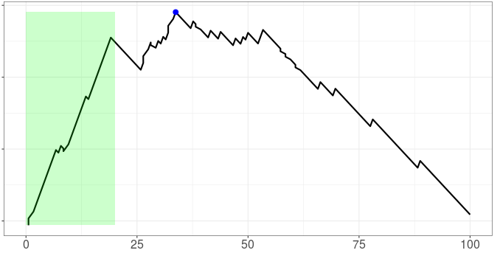
What is the achievable utility, given work capacity?
Max utility
Utility per patient
Feasible given capacity
Rank ordered list of cases
A framework for making predictive models useful in practice Kenneth Jung et al. https://doi.org/10.1093/jamia/ocaa318

Slide 26
What is the effect of constraints on different parts of the workflow?
Factor | Description | Value | Range
Failure rate | Fraction of patients for whom ACP is not possible for external reasons | 0.1 | 0.1, 0.2, 0.3
Daily capacity | Daily capacity to carry out ACP | 3 | 1, 2, 3, 4, 5
Mean time to complete ACP | Mean time in days to complete ACP, parameter to exponential distribution. | 2 | 1, 2, 3, 4
Outpatient pathway rescue rate | Rate of successful ACP by outpatient pathway. | NA | 0, 0.25, 0.50, 0.75, 1.0
Impact of capacity constraints
A framework for making predictive models useful in practice Kenneth Jung et al. https://doi.org/10.1093/jamia/ocaa318
Notes:
Summary of simulations.
Our simulations sample the number of admission per day from historical data, and then take a bootstrap sample of patients for which we have both model output and admission information.
This figure summarizes how each sampled patient is categorized as one of true positives, false positives, true negatives, and false negatives under the full simulation considering various factors that may alter this categorization.
Under the optimistic scenario, this disposition depends solely on whether the model agrees or disagrees with an expert clinician’s judgement.

Slide 27
Remember
Treat the model’s output as a way of ranking; and focus on your capacity for taking action/s
7
Figure out your threshold to act given the model output
8
Ask whether the action taken can make a difference
9
Define, measure, and monitor the outcome you hoped to change
10
Don’t get hung up on AUROC, AUPRC, and the probability estimate. Focus on precision @ K
Set the threshold such that the there is a 10-15x lift in the chance of having the condition
Connect with steps 1, 2
(needs statement and use case) in FURM assessment
Connect with steps 10, 11 (monitoring, prospective eval.)
in FURM assessment
Notes:
Connect point 7 to slide 27
Connect point 8 to slide 26

Slide 28
Liability & Regulation

Slide 29
You develop a model that predicts what dose of cancer medication (15 mg/kg, 50 mg/kg, 75 mg/kg) a patient should get based on a set of risk factors. Standard of care dosing is 15 mg/kg.
It works so well in your evaluations that Hospital X buys and starts to use it! However, once deployed a clinician uses the model to prescribe a 75 mg/kg to a patient, and the patient suffers severe side effects. The patient sues. Who should be liable?
Discuss in small groups.

Slide 30
Potential Liability for Physicians Using AI
15 mg/kg
15 mg/kg
75 mg/kg
15 mg/kg
75 mg/kg
A physician faces liability only when they do not follow the standard of care and an injury results
Current law incentivizes physicians to use AI as a confirmatory tool to support existing decision-making, rather than as a source of ways to improve care!
Price WN, Gerke S, Cohen IG. Potential Liability for Physicians Using Artificial Intelligence. JAMA.
Published online October 04, 2019. doi:10.1001/jama.2019.15064
Notes:
The Figure presents potential outcomes for a simple interaction—for instance, when an AI recommends the drug and dosage for a patient with ovarian cancer.
Assume the standard of care for this patient would be to administer 15 mg/kg every 3 weeks of the chemotherapeutic bevacizumab.

Slide 31




Regulation is a work in progress
The model -- the equation relating the inputs to output
The reliability (of the model) over time, sites, populations
Increase in quality of care by using the model to guide care
Increase in value of care by using the model to guide care
Software as a
medical device (SaMD)
As a digital, laboratory developed test (LDT)
Cert. as practice management software
Software as a therapeutic (DTx)
Notes:
The model (i.e. the equation relating the inputs to output) and its validity (over time, or across sites).
The betterment of care provided by using the model to guide care
Increase in value of care by using the model to guide care

Slide 32
In addition: Using AI in healthcare has other open ethical questions
Ensuring fairness and equity of decision making based on the output of AI agents (classifiers and predictors).
The degree of autonomy, and decision-making authority, granted to algorithmic agents.
The changes in agency, and fiduciary responsibility in the doctor-patient relationship.
Balancing the competing needs for data-access, transparency of analysis, and patient privacy.

Slide 33
Assigned reading
Wynants L, van Smeden M, McLernon DJ, Timmerman D, Steyerberg EW, Van Calster B. Three myths about risk thresholds for prediction models. BMC Med. 2019 Oct 25;17(1):192. doi: 10.1186/s12916-019-1425-3. PMID: 31651317; PMCID: PMC6814132.

Slide 34
More on topics covered today: classes at Stanford that may be of interest
Winter
EPI 219: Evaluating Technologies for Diagnosis, Prediction, and Screening
CHPR 212/HRP 218/MED 212: Methods for Health Care Delivery Innovation, Implementation, and Evaluation
Spring
BIOMEDIN 223/EPI 220: Deploying and Evaluating Fair AI in Healthcare

